Slide 1
Unit 6 Project...Wind Infrastructure across the USA
File created on: 1/28/2022 10:29:05 PM

Slide 2
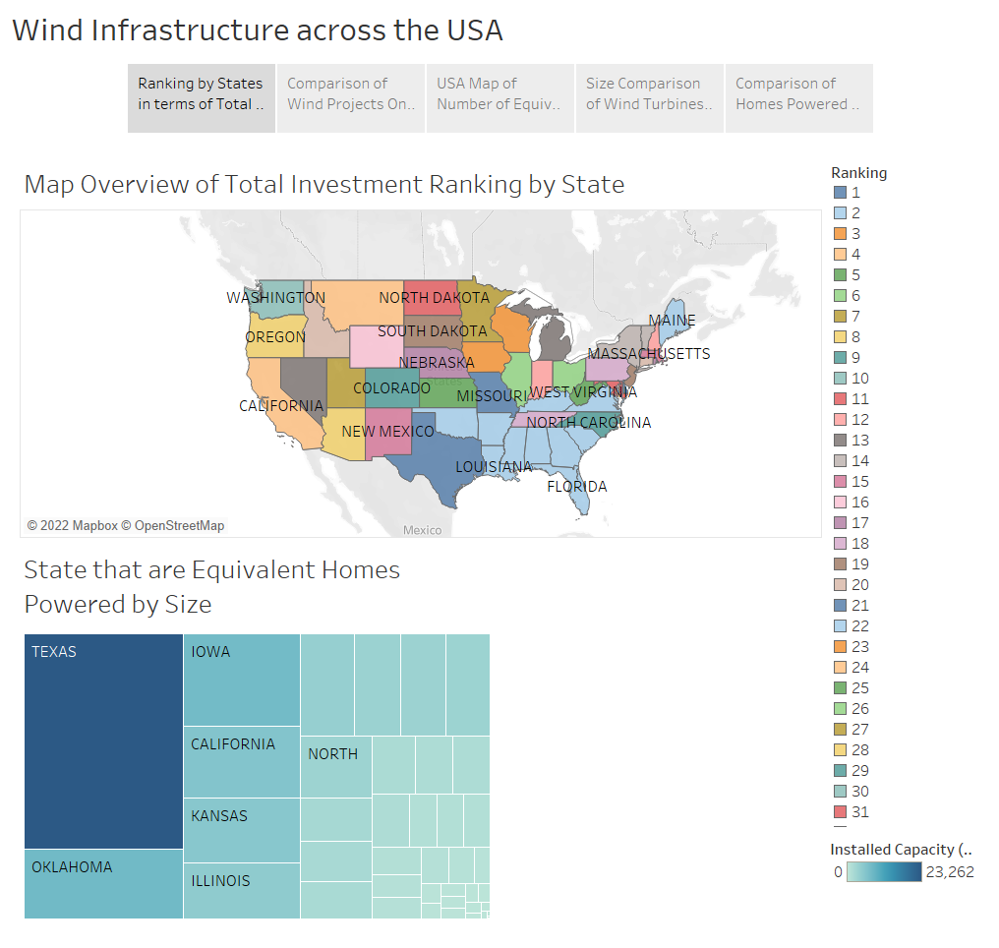

Slide 3
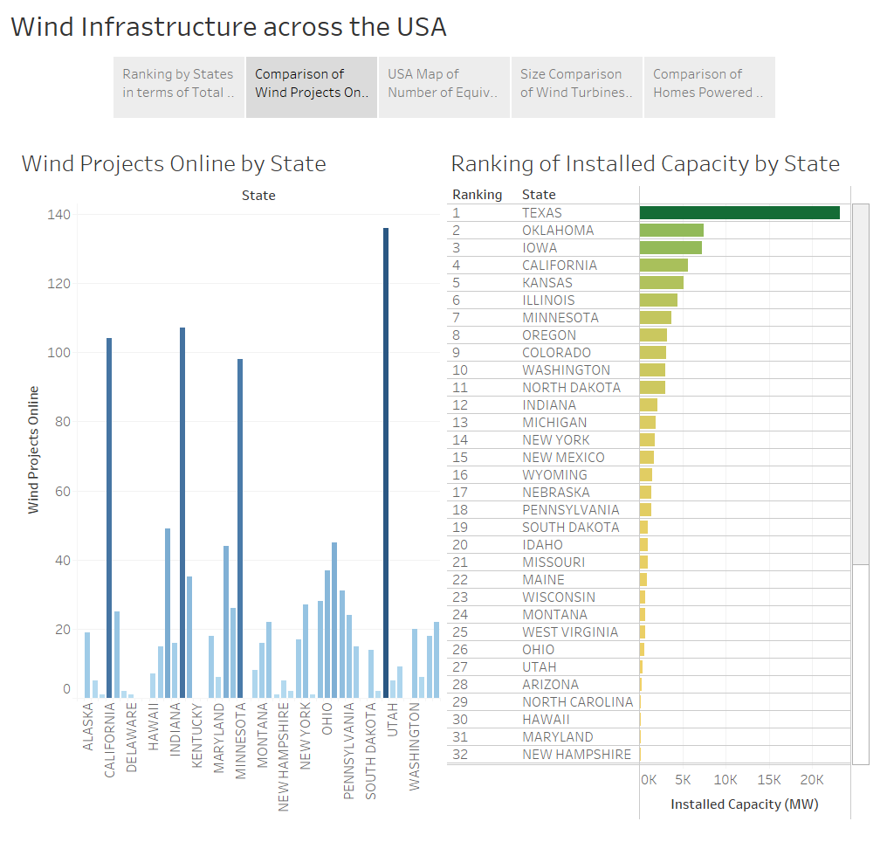

Slide 4
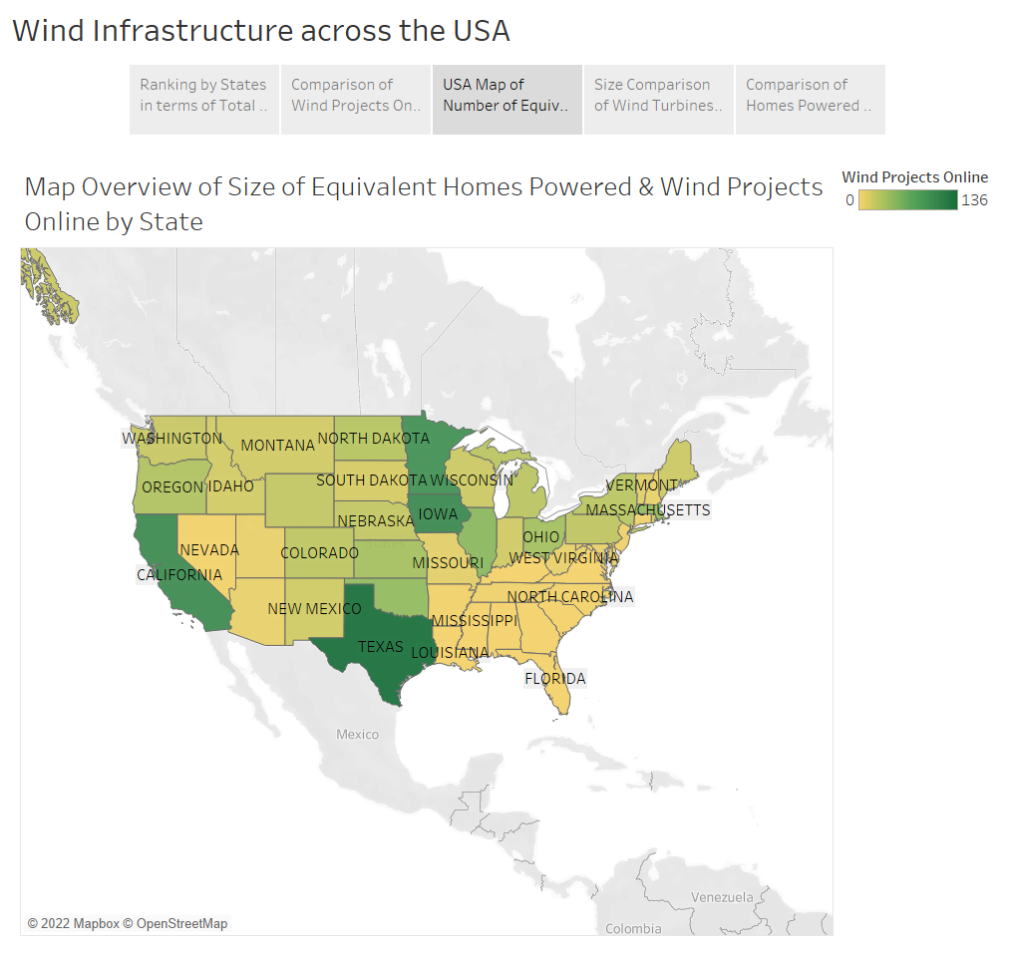

Slide 5
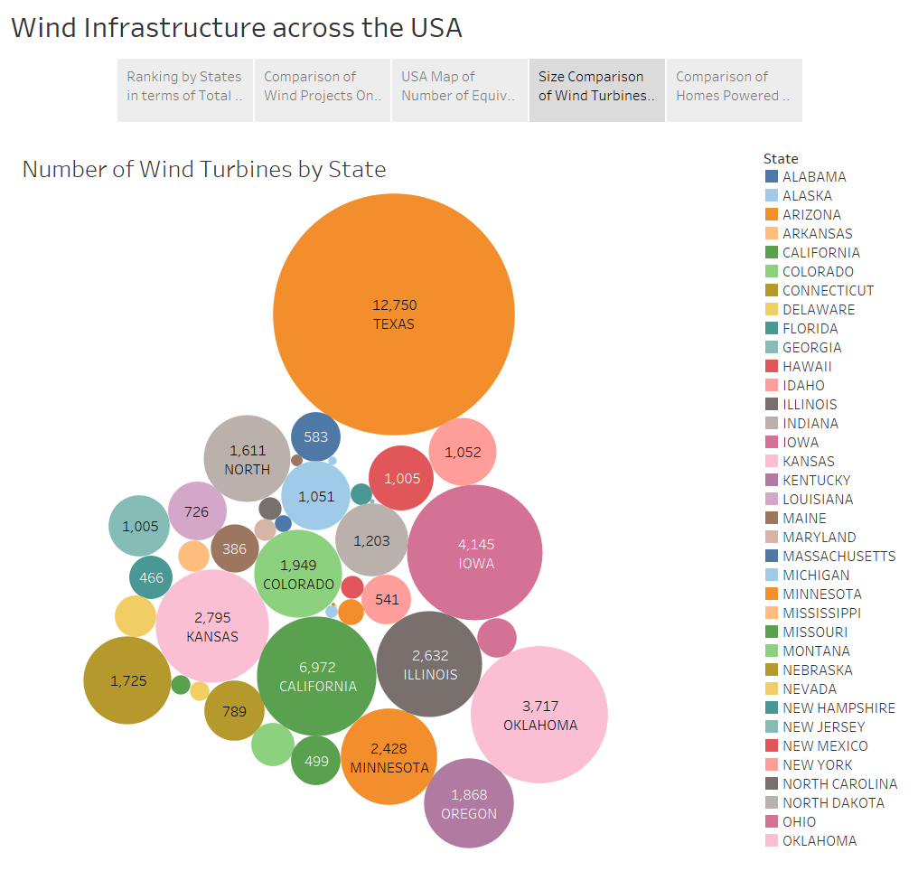

Slide 6
